Slide 2














Your platform for building anything
DESKTOP
WEB
CLOUD
MOBILE
GAMING
IoT
AI
.NET
Notes:
You can build anything with .NET.
We’ve made significant investments in .NET over the years as well as unifying the ecosystem to support building literally anything. From desktop to gaming to the cloud, .NET is a general purpose programming platform that enables all kinds of application scenarios. Once you learn one, you can easily pick up another.

Slide 3
What’s new, hot, & awesome for Xamarin developers!
Khuong Nguyen

Slide 4
What is Xamarin?

Slide 5




























Xamarin
Loved by developers, trusted by enterprise aka.ms/xamarin-showcase
Notes:
In fact there are tons of companies that entrust Xamarin and .NET today.
These companies leverage Xamarin and .NET across all verticals and all different types of platforms.

Slide 6
An open source app platform
from Microsoft for
building modern & performant
iOS, Android, macOS,
watchOS, & tvOS apps with .NET.

Slide 7

Xamarin
iOS & Android with C#
Native performance, native APIs, native UI
Build native mobile apps with Visual Studio
Cross-Platform
Build cross-platform UI with Xamarin.Forms
Access native APIs from shared code with Xamarin.Essentials
Share code with .NET Standard
Free & Open Source
Xamarin is part of .NET and open source on GitHub

Slide 8

Xamarin App Architecture
iOS C# UI
Android C# UI
Windows C# UI
Shared C# Logic
Shared C# codebase • 100% native API access • High performance

Slide 9












Native API Access

Slide 10

Xamarin.Essentials
Secure Settings
Sms
Preferences
Flashlight
Clipboard
Gyroscope
Magnetometer
Geolocation
Phone Dialer
Device Display Info
Email
Device Info
Battery
Compass
Accelerometer
Screen Lock
Data Transfer
Text to Speech
Geocoding
File System
Connectivity
Vibration
aka.ms/xamarinessentials
Notes:
Which is Xamarin.Essentials. An open source library that abstracts common native features into a single cross platform API for iOS, Android, and Windows. These are APIs that exist across each platform so why not bring them together.

Slide 11
Development Productivity

Slide 12



Slide 13

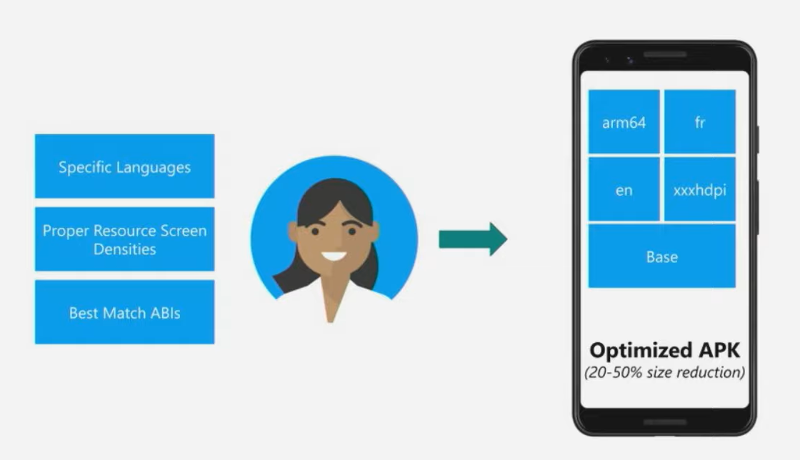

Slide 14
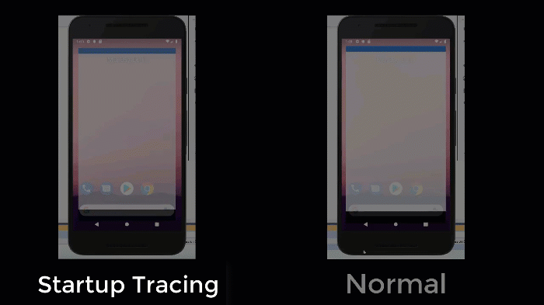
Startup Tracing On Android

Slide 15

Xamarin.Forms
Notes:
What about the user interface? Just like APIs you can build the native UI for each platform. However, many developers choose to share all or most of the UI with Xamarin.Forms

Slide 16
An open source mobile UI framework
from Microsoft for building
iOS, Android, & Windows apps with .NET
from a single shared codebase.

Slide 17
Xamarin
+ Xamarin.Forms
iOS C# UI
Android C# UI
Windows C# UI
Xamarin.Forms
Shared C# Logic
Shared C# Logic
Traditional Xamarin approach
With Xamarin.Forms: More code-sharing, all native

Slide 18

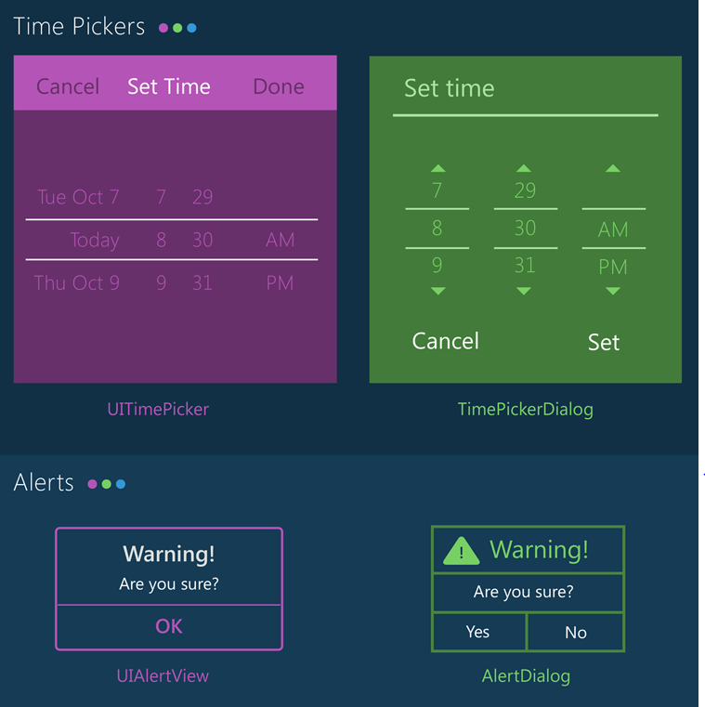
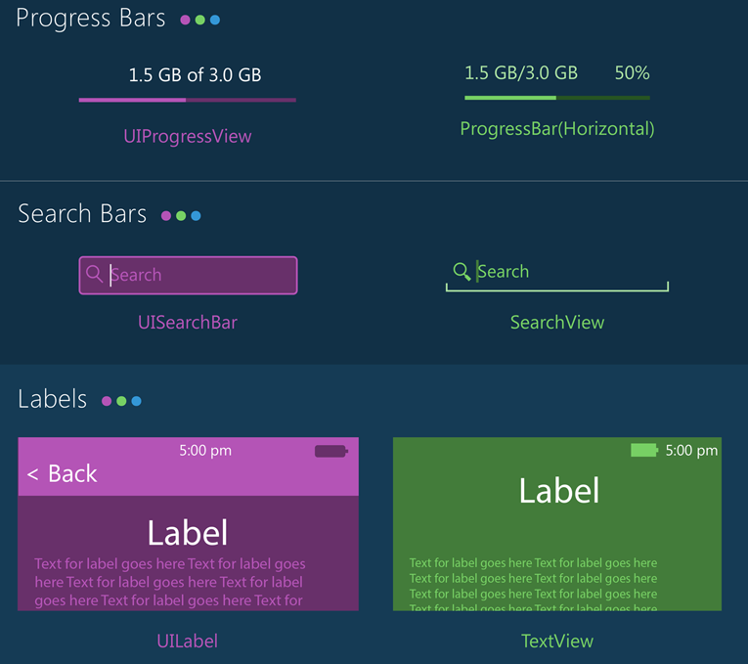
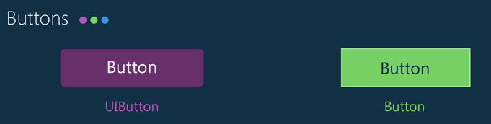
Notes:
With Xamarin.Forms you get the native controls on each platform so you app looks and feels native to the platform. However, with Xamarin.Forms and the new Visual API you can bring together your apps with a more similar material design look and feel.

Slide 19
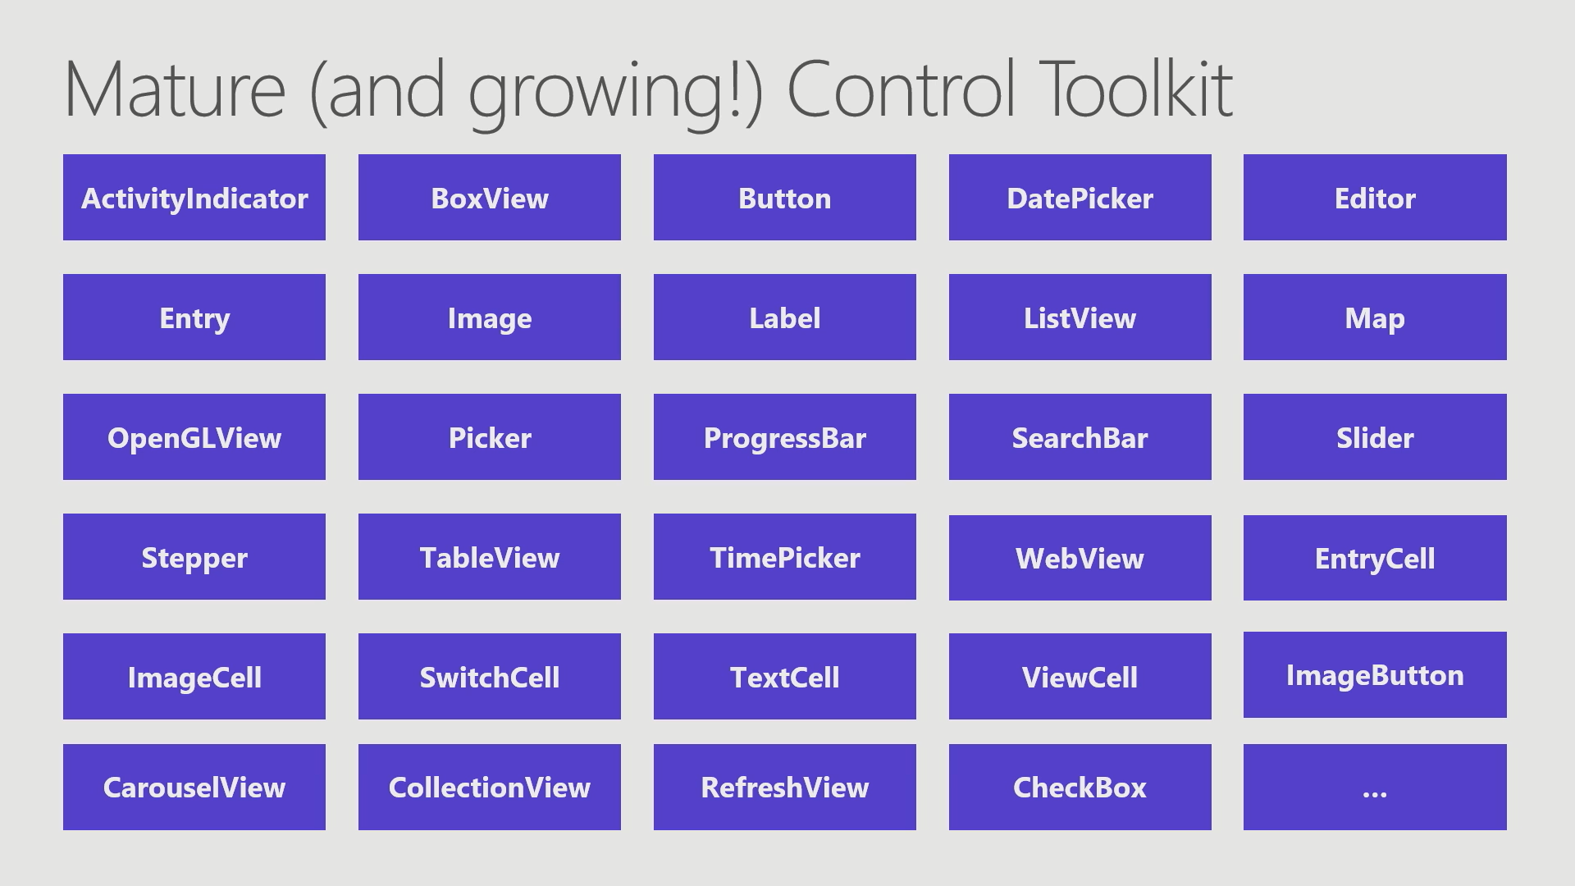

Slide 20
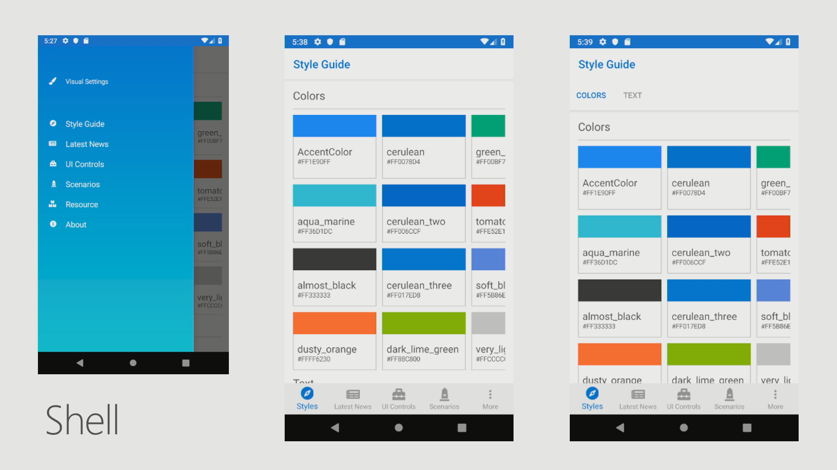

Slide 21
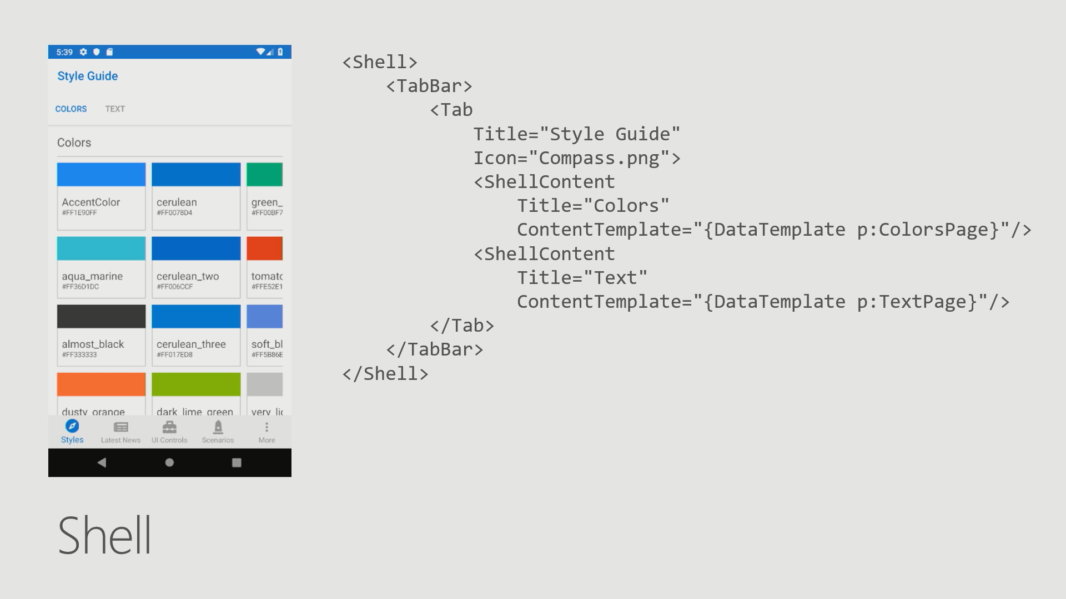

Slide 22
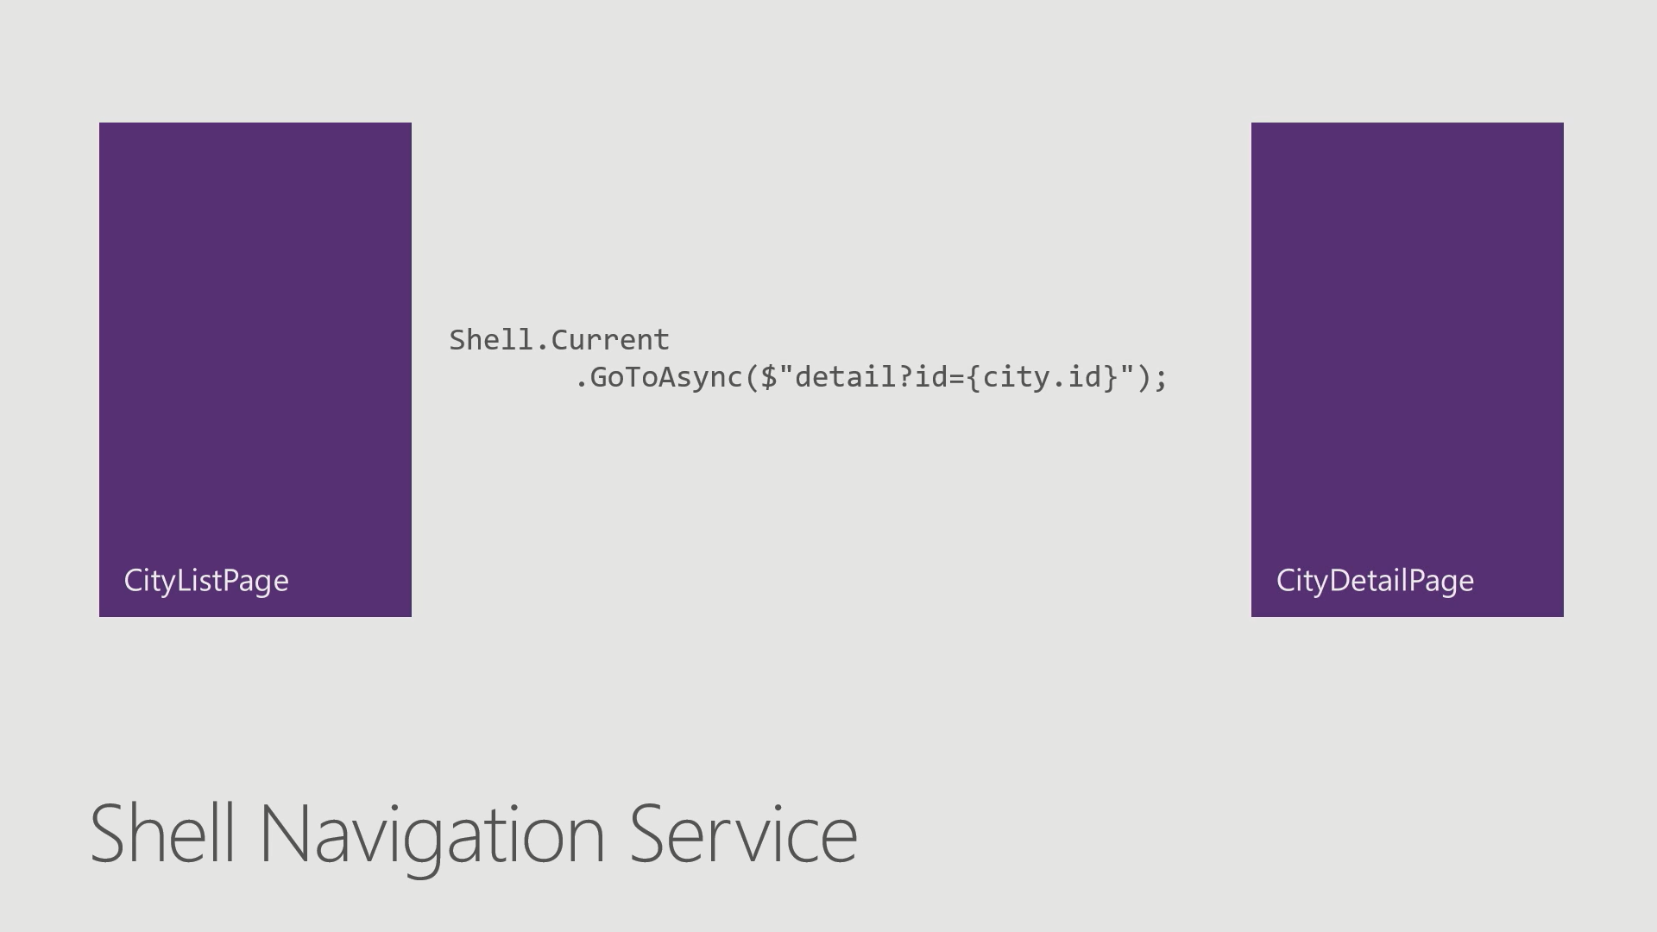

Slide 23
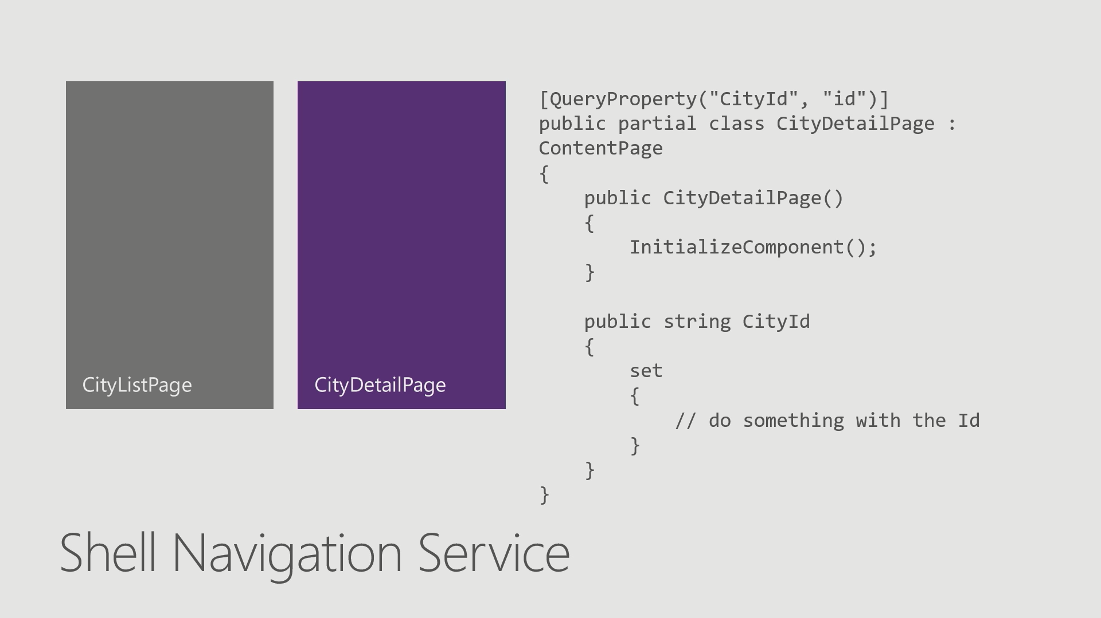

Slide 24
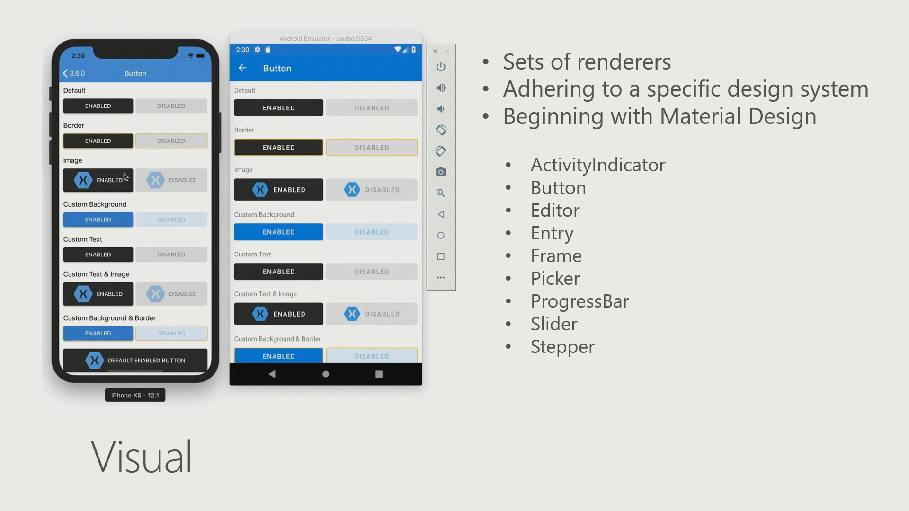

Slide 25
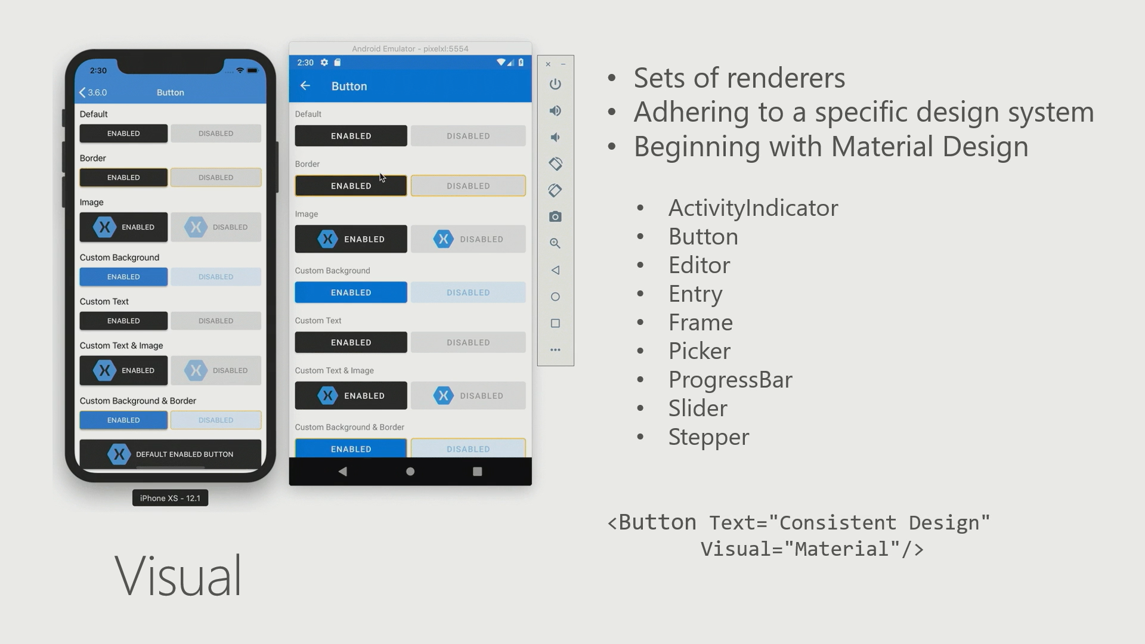

Slide 26
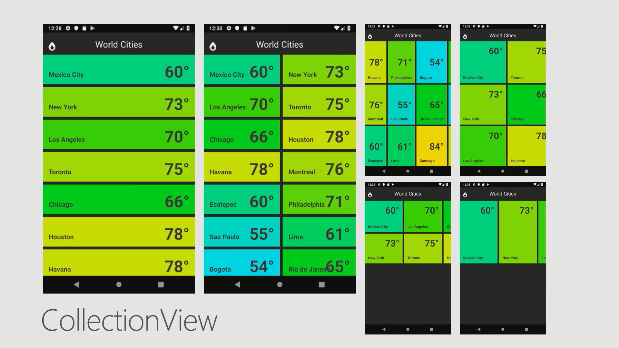

Slide 27
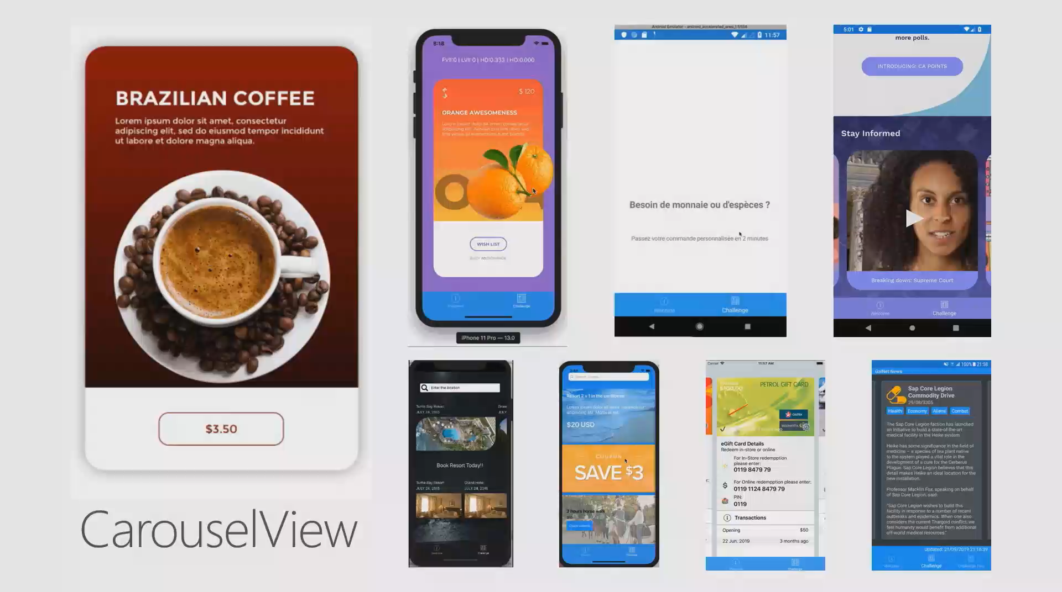

Slide 28
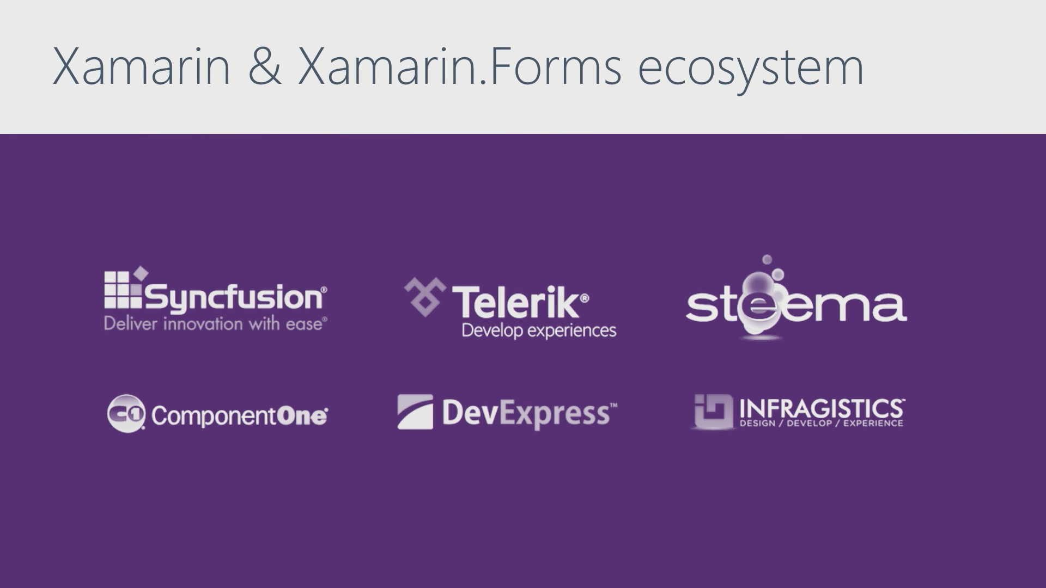

Slide 29
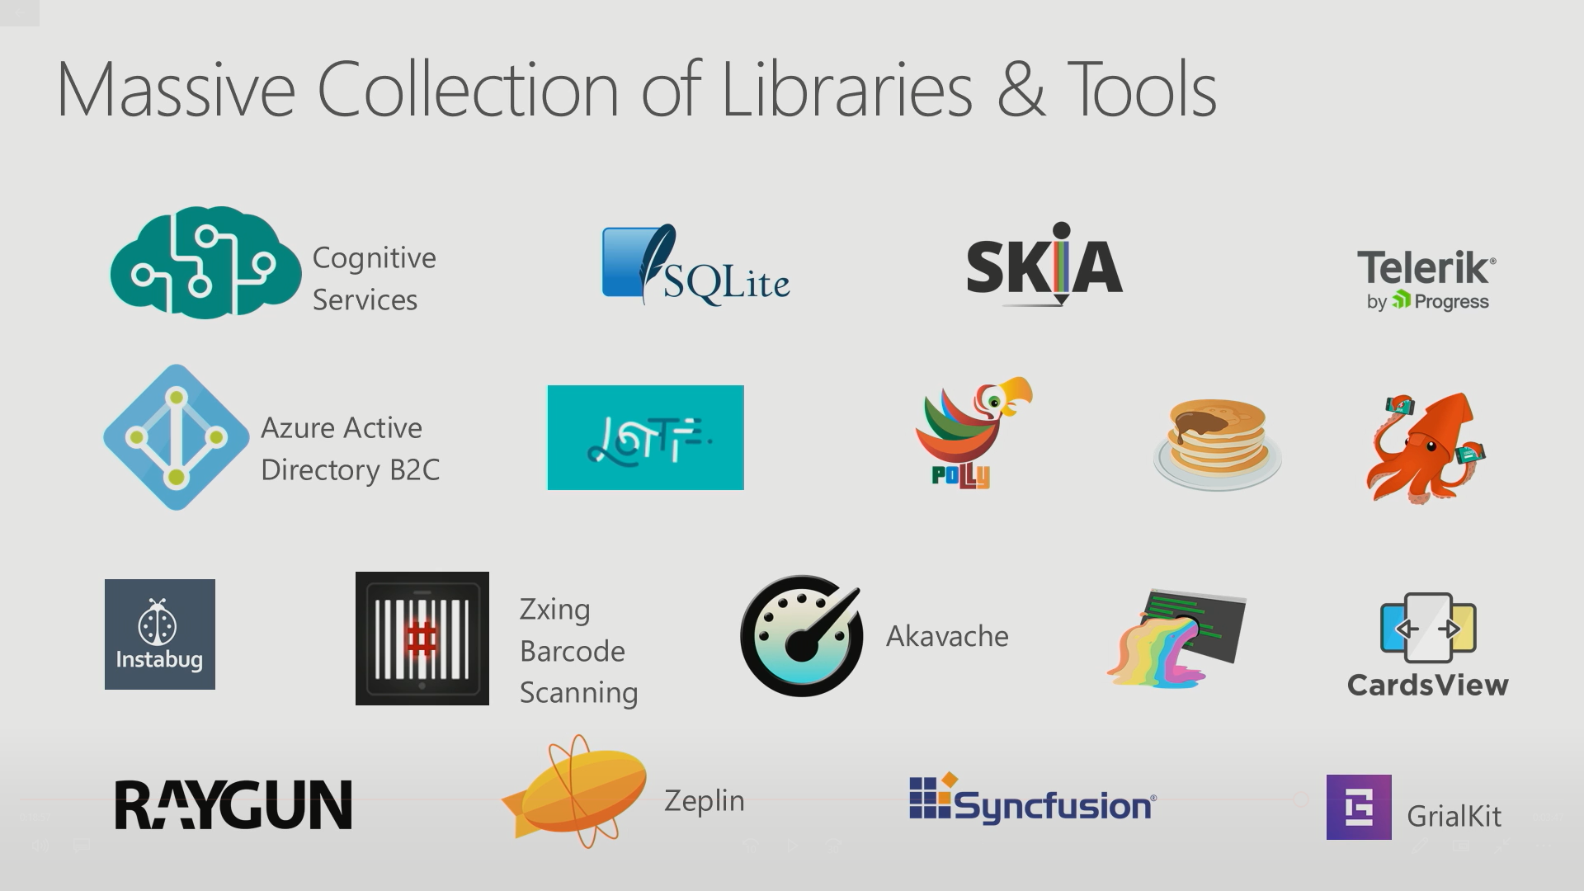

Slide 30
Xamarin is included in Visual Studio
Including Community Edition!
Notes:
First, we should mention that Xamarin is part of Visual Studio! Including the free community edition! So if you already have Visual Studio, you have Xamarin and if you don’t it is free to make and ship apps.

Slide 31

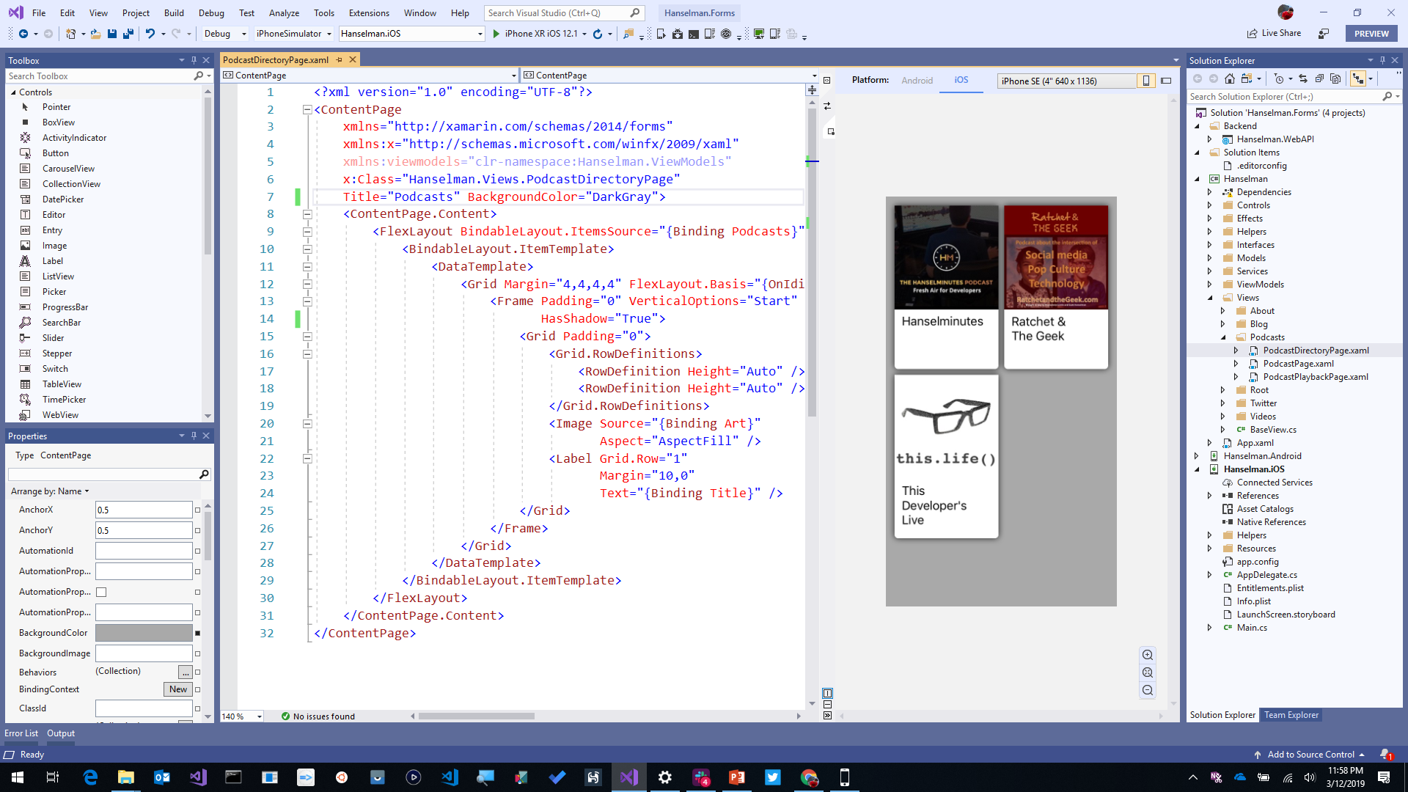
Visual Studio 2019
iOS, Android, Desktop, Web, Cloud, and More!
Advanced IntelliSense & Code Cleanup
Enhanced Collaboration with Live Share and Pull Request Experience
Advanced Debugger & Search Windows
Simple Connected Services to Deploy to Azure
Notes:
All of this work can be done in an astonishing IDE, Visual Studio! You can harness the complete power of this IDE and all of it’s amazing Intellisense, code cleanup, and extensions, and build iOS and Android apps directly on your Windows PC.

Slide 32

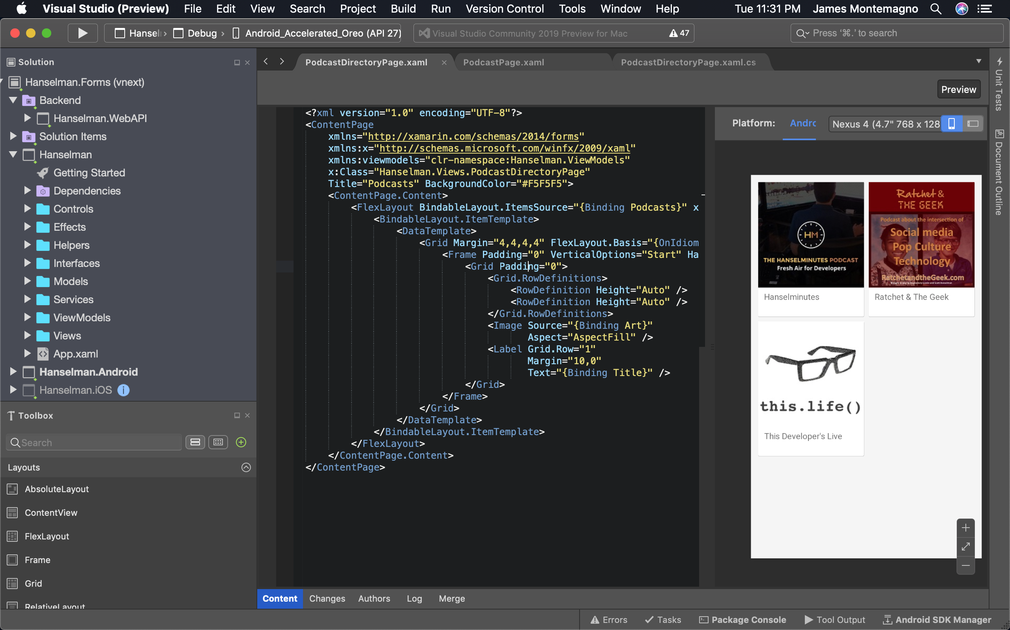
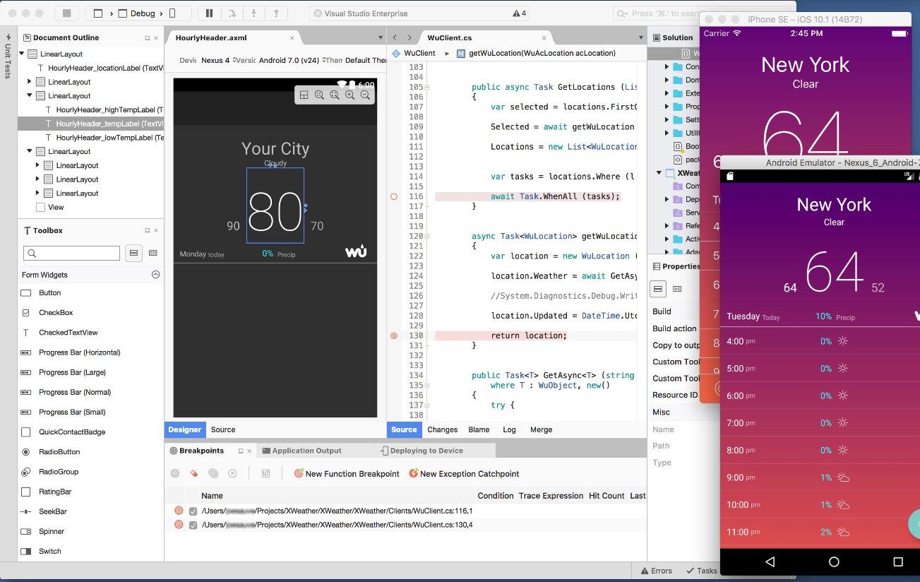
Visual Studio 2019 for Mac
.NET Centric
Focused on .NET Developers
.NET Core
ASP.NET Core Web Apps & APIs
Unity
Develop and Debug Unity Game Code
Xamarin
Mobile: Android, iOS, watchOS
macOS, tvOS
Azure
Connected Services
Easy Deployment
Azure Functions
Notes:
Best of all there is Visual Studio for Mac, bringing many workloads from Windows directly to macOS. The same projects and same solutions open.

Slide 33
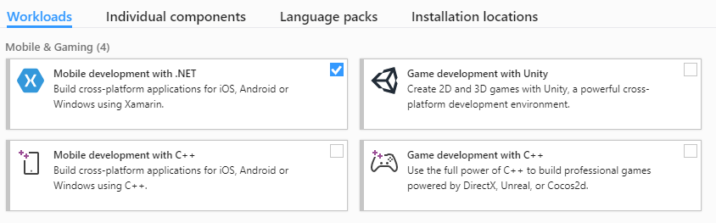
Visual Studio Integration
Notes:
It is easy to get started with just a single click.

Slide 34
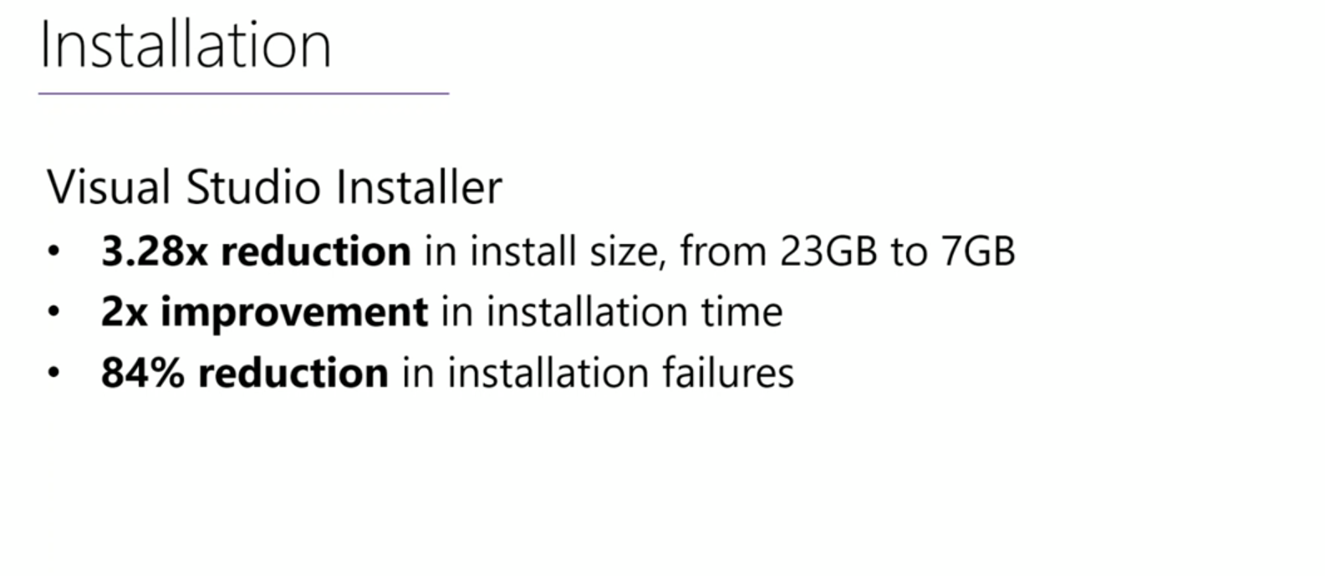

Slide 35
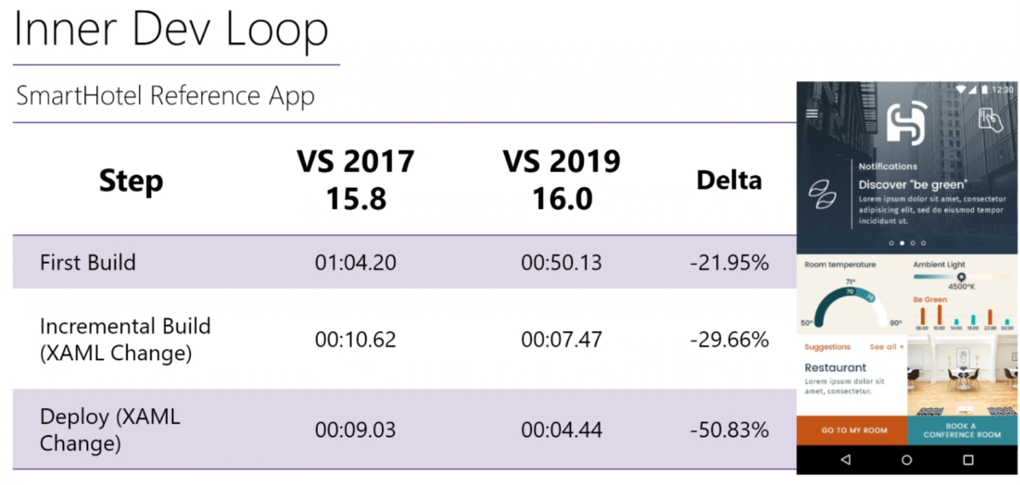

Slide 36
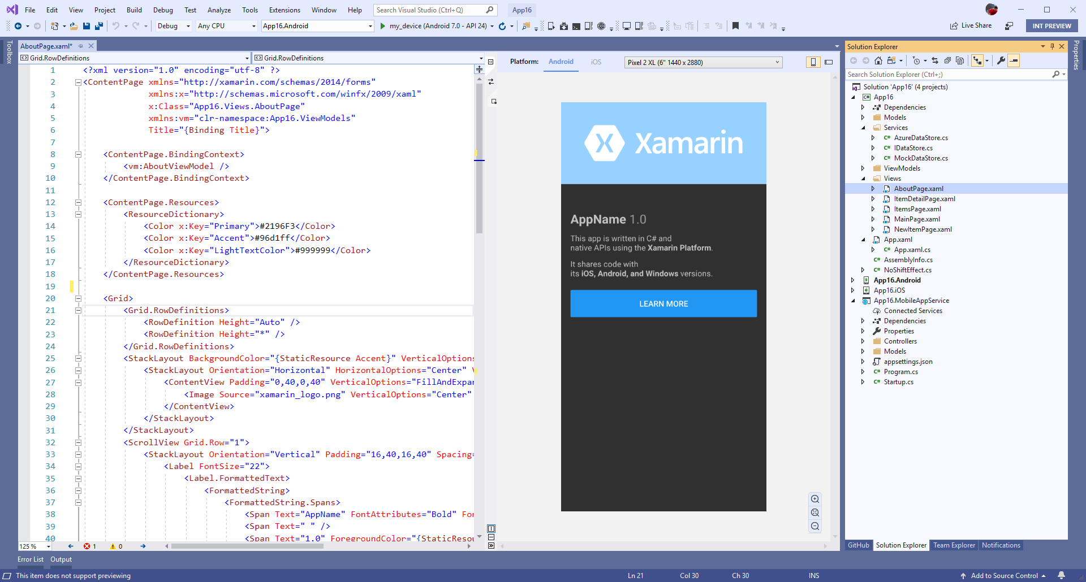
Xamarin.Forms Previewer
Quickly preview a visualization of your user interface
Drag & Drop Controls to XAML and modify in property panel
Target multiple screen sizes and resolutions of iOS & Android devices.
Preview data with design time attributes
Notes:
Built in is several designers and previewer for Xamarin.Forms for iOS and Android.

Slide 37
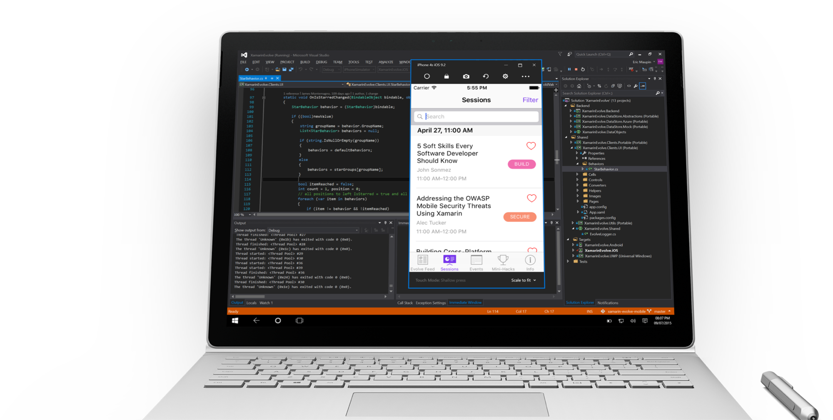
Visual Studio iOS Simulator Remoting
Multi-Touch Enabled
Pressure Sensitive
Super Fast
Rotate, screenshots, location changes
Never leave VS
Notes:
From your Windows machine you can directly launch the remoted iOS simulator!

Slide 38
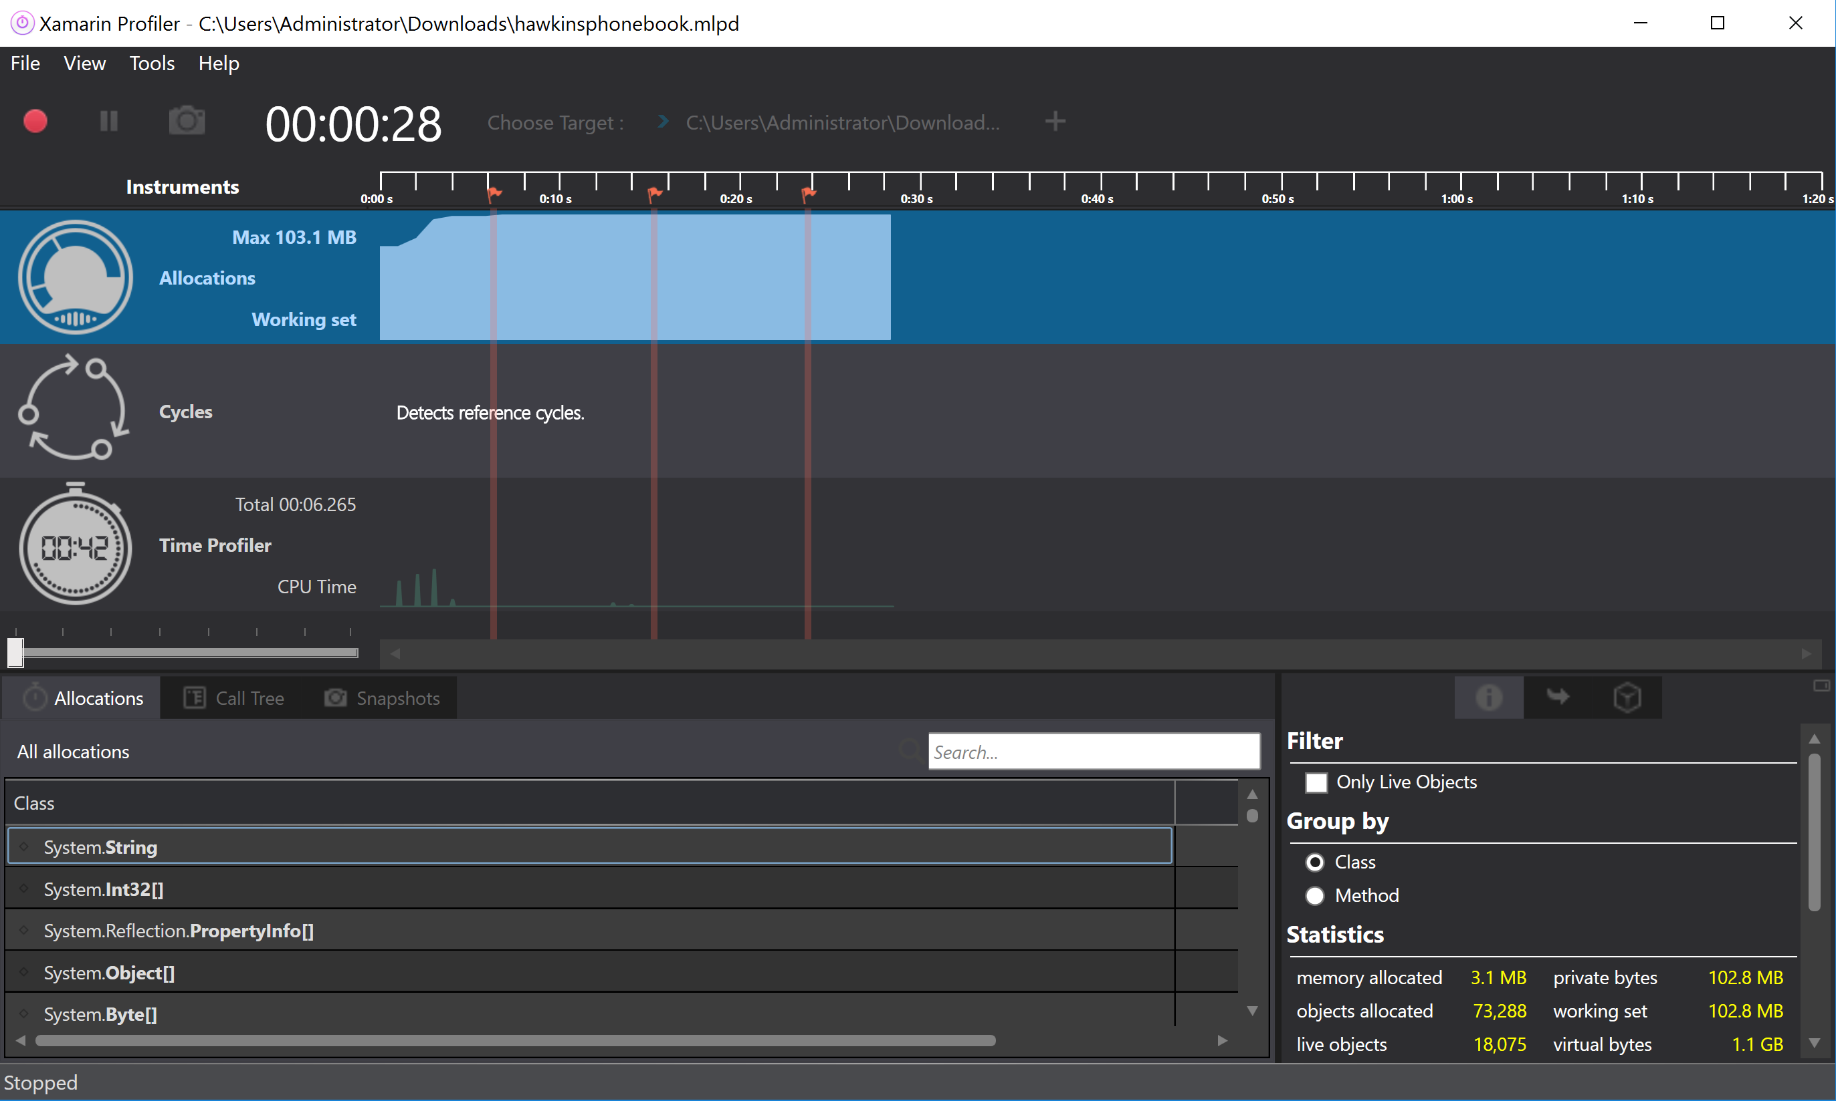
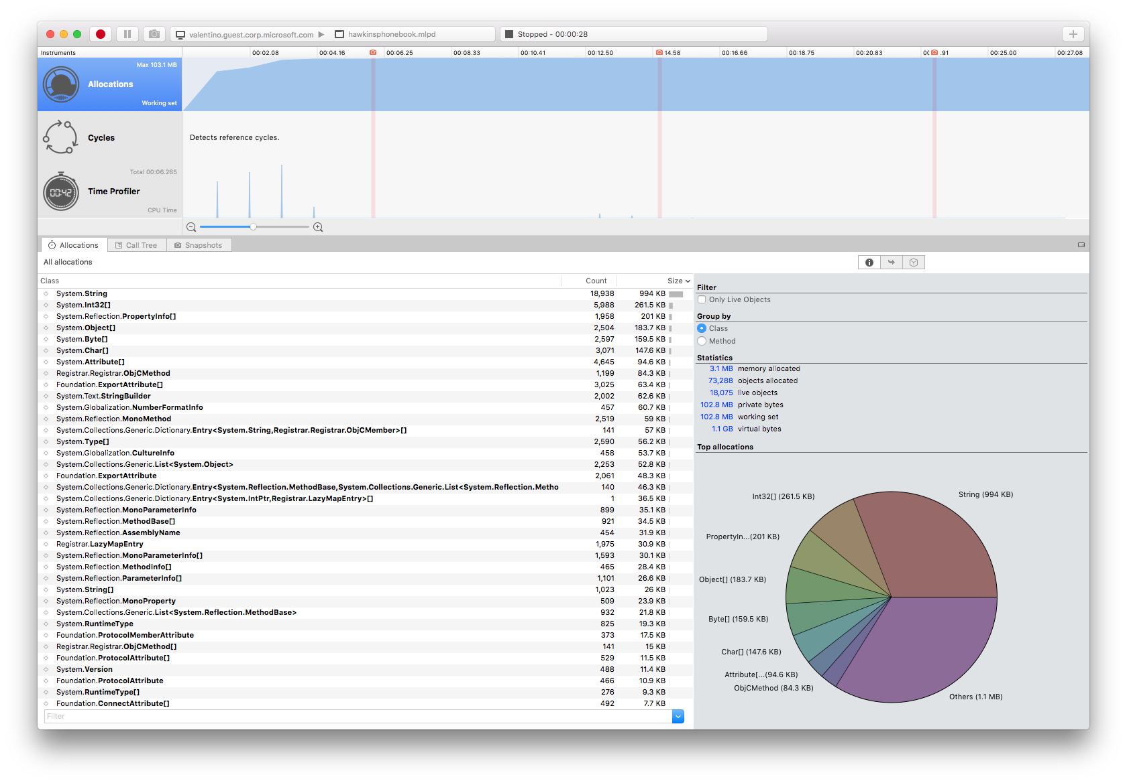
Xamarin Profiler
Analyze & Polish Apps
Key Instruments:
Allocations
Time Profiler
Cycles
Snapshots & More
*Enterprise
Notes:
If you are a Visual Studio enterprise customer you can take advantage of the profiling tools for Xamarin.

Slide 39



Visual Studio IntelliCode
Code with confidence
Find issues Faster
Focused code reviews
*VS 2019
Notes:
There is a lot more that Visual Studio offers such as intellicode which helps you write code faster with AI assisted Intellisense.

Slide 40
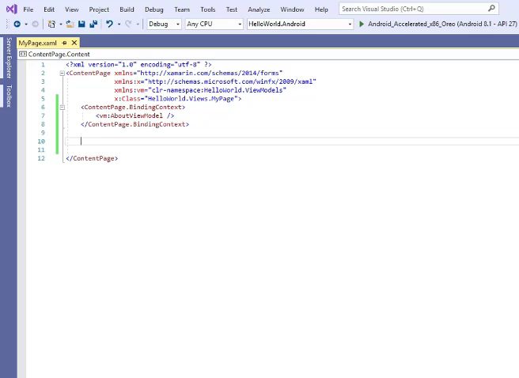
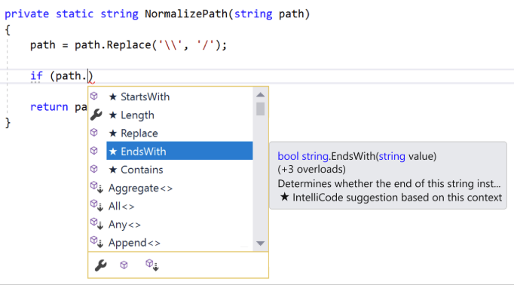
IntelliCode Support for C# & XAML
Assisted IntelliSense for C# & XAML
*VS 2019
Notes:
This works not only for C#, but also Xamarin.Forms XAML.

Slide 41
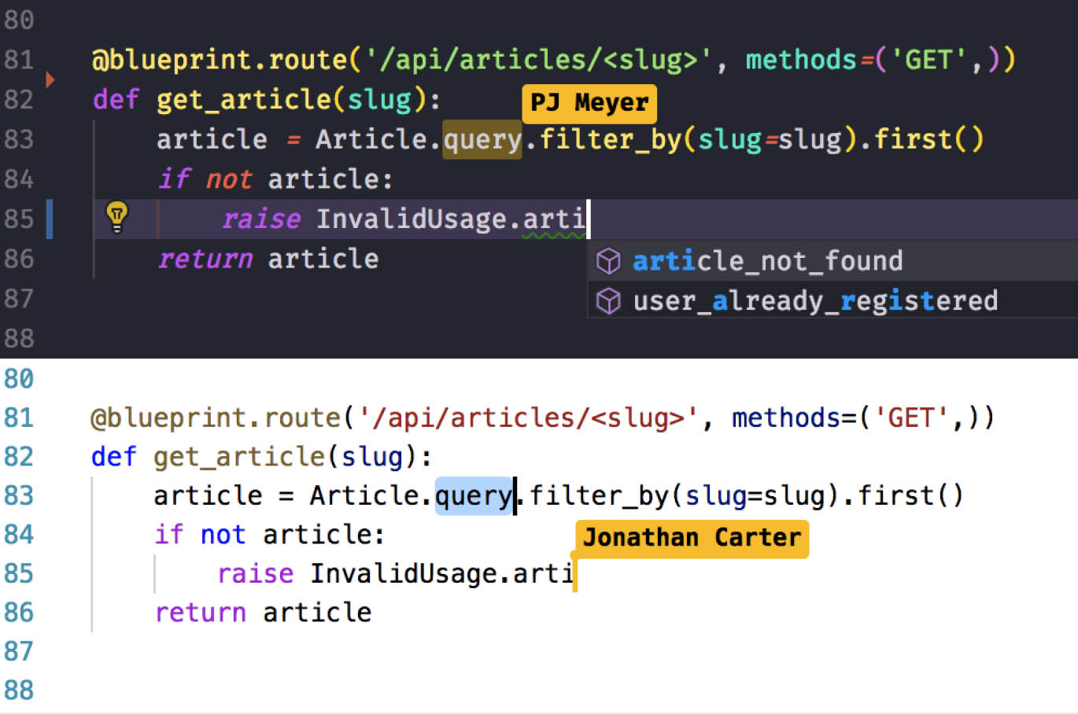
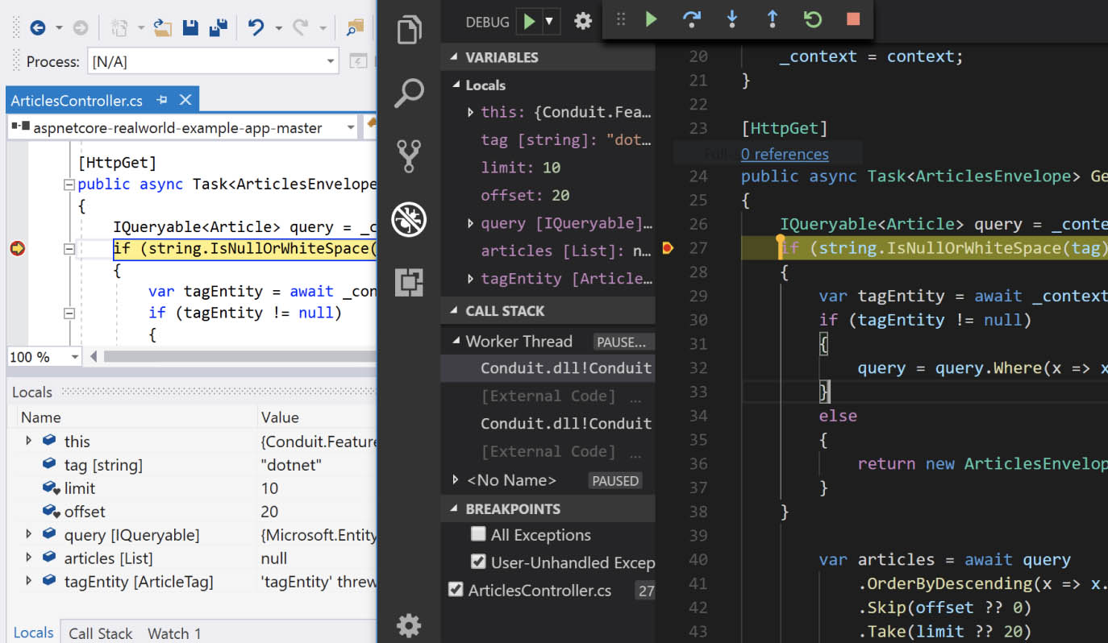
Visual Studio Live Share
Real-time collaborative development
No-hassle sharing for any language, any app
Collaborate from the comfort of your favorite tool
*VS 2019
Notes:
Since Xamarin apps are built inside of Visual Studio you can take advantage of other services such as Live Share to do collaborative coding.

Slide 42
PREVIEWS
Xamarin Developer Productivity
XAML Hot Reload
Iterate quickly on your Xamarin.Forms UIs while debugging
Hot Restart
Quickly redeploy your Xamarin.Forms app without a full compile
aka.ms/XAMLHotReload
aka.ms/HotRestart
Notes:
Xamarin continues to enable more developer productivity features like XAML Hot Reload and Hot Restart which will significantly speed up your mobile development.
If you grab the latest versions of Visual Studio 2019 and Visual Studio 2019 for Mac, you’ll be able to try out these previews.

Slide 43
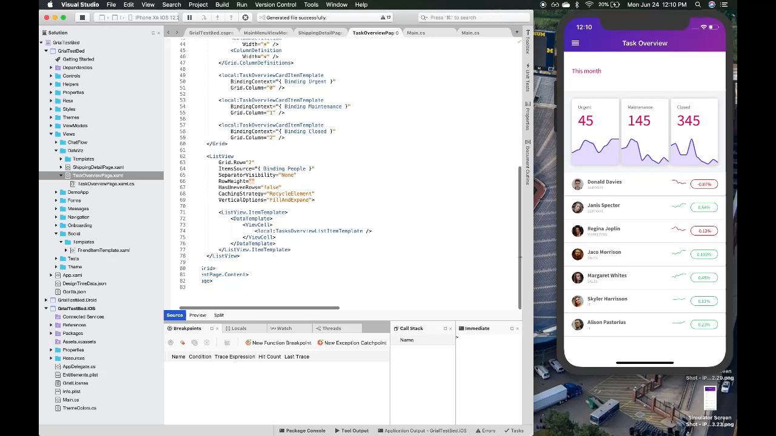

Slide 44


Slide 45
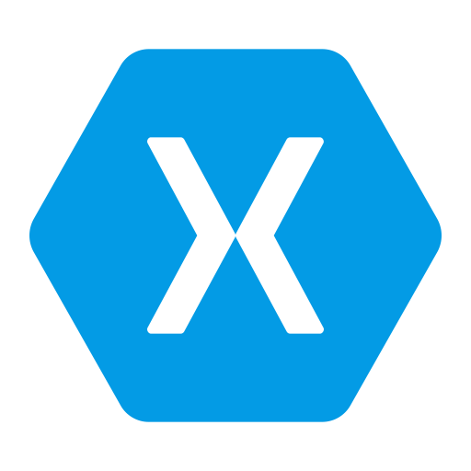

Notes:
Naturally Xamarin and .NET apps work absolutely amazing for cloud apps with Microsoft Azure.

Slide 46










.NET cloud apps run best in Azure
Azure Storage
Azure Cosmos DB
Azure App Service
Azure Functions
Azure App Insights
Azure Service Fabric
Azure SignalR Service
Azure Virtual Machines
Azure SQL Database
Azure Cognitive Services
Azure Kubernetes Service (AKS)
And many more…
Extend apps with serverless, event driven tasks
Commoditized AI
Fully managed platform perfect for running .NET Framework and .NET Core web apps and services
Application performance and usability monitoring
Build native .NET, fully managed, scalable microservices
Relational Database
Non-Relational Database
Fully managed real-time web functions, like chat, gaming, tickers, collaboration and more
Store anything. Great for binaries
Container orchestrator for Linux workloads (.NET Core)
Notes:
No matter what you may need, there is a service in Azure for you. From serverless compute with Functions to realtime communication with SignalR, or databases with SQL and Cosmos DB there are great cross-platform SDKs for .NET.

Slide 47
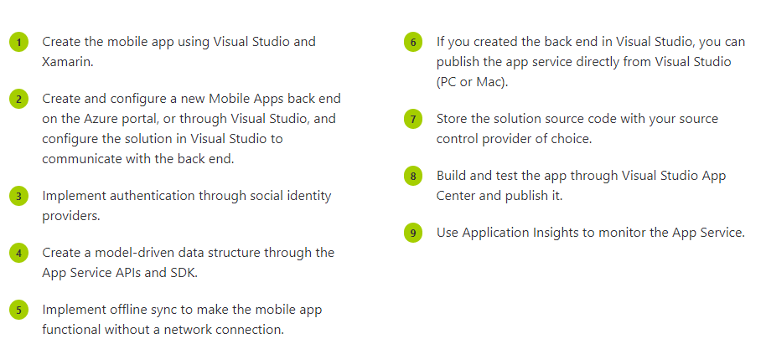
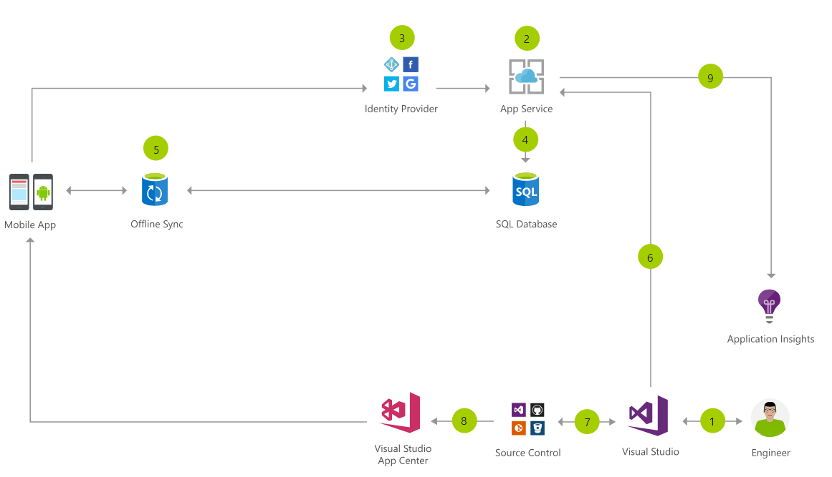
Cloud Mobile App Architecture
Notes:
Here is an example of what a cloud mobile app may look like.
You have your app, with identity providers with Azure AD B2C, and app service talking to SQLite and a sync later using App Service. You can export all of your data into App Insights and continuously monitor and ship with Azure DevOps and App Center.

Slide 48
Azure DevOps
Complete DevOps solution
Code Repository
Build + Deploy
Test Cloud
User Beta Testing
Monitoring/Analytics
<//>
Developers
Notes:
Azure DevOps not only works great with Xamarin apps, but all apps! Giving you a full end to end develop lifecycle.

Slide 49

















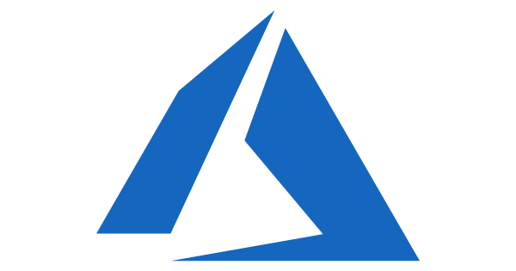
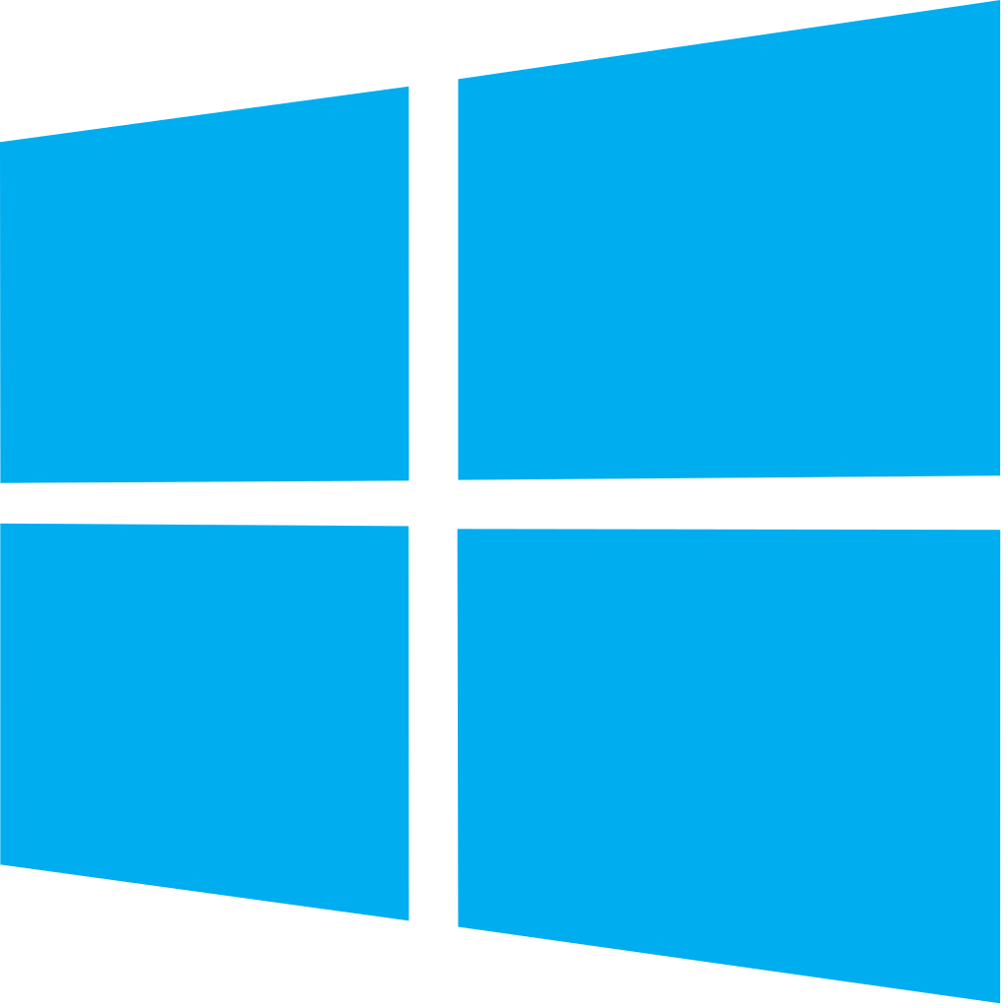
Azure DevOps: Choose what you love
Your tools, languages, and clouds
Azure DevOps lets developers choose the tools and languages that are right for them
Mix and match to create workflows with tools from Microsoft, open source or your favorite third-party tools
Target any cloud, on-prem or both and deploy to the servers you need
Notes:
You can pick and choose what you want to use and even integrate other clouds or on premise servers.

Slide 50
Azure DevOps
Azure Boards
Azure Pipelines
Azure Repos
Kanban Boards, Backlogs, Dashboards, and Reporting
CI/CD platform, FREE for open source projects
Unlimited, Cloud-Hosted Private Git Repos
Azure Test Plans
Azure Artifacts
Manual and Exploratory Testing Tools
Package Management for Maven, npm, and NuGet.
https://azure.com/devops
Notes:
There is tons of FREE in Azure DevOps to start today.

Slide 51
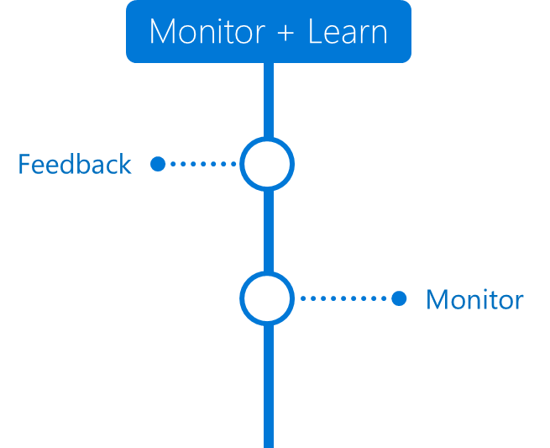




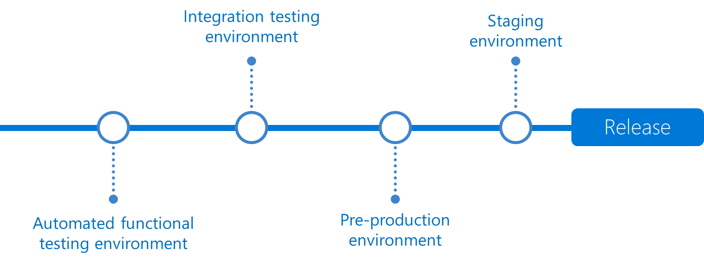



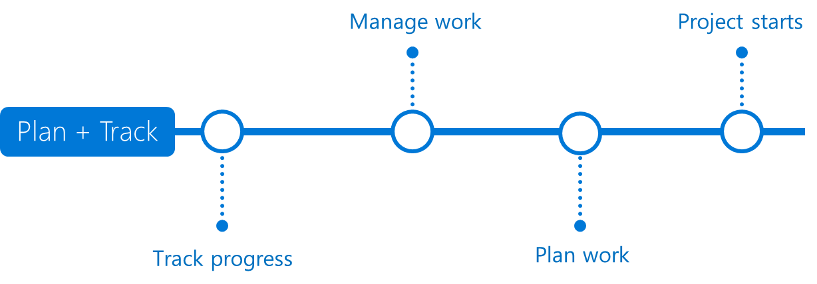








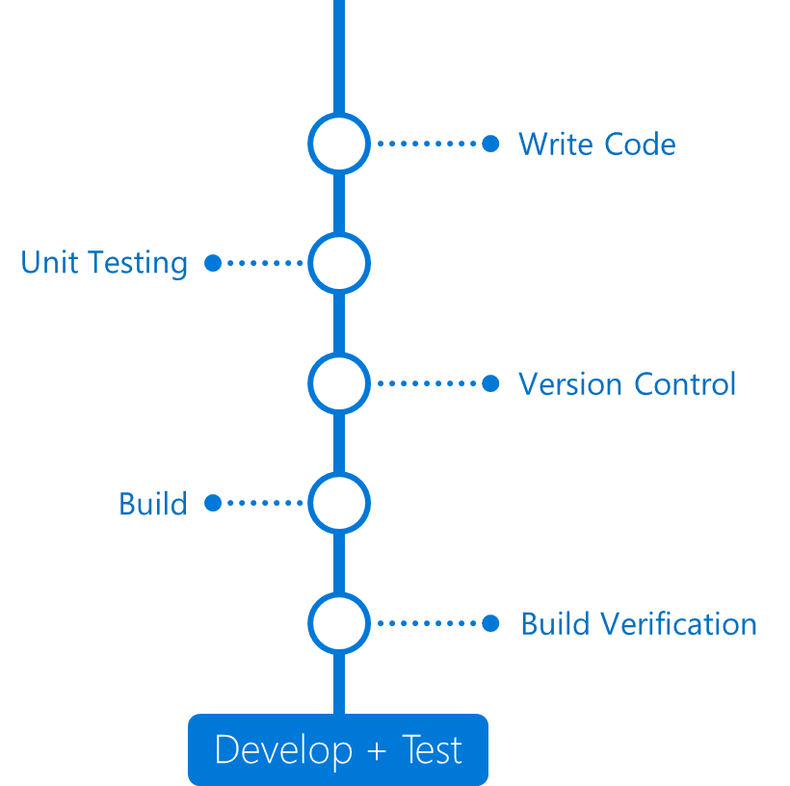












Any Language
Any Platform
DevOps
DevOps

Slide 52














Slide 54


App Center’s focus on creating simple user experiences
Microsoft Authentication Library (MSAL):
Displays login UI (B2C default or developer custom)
Interacts with B2C to manage credentials, expiration, etc.
Robust and reliable capabilities of Azure AD B2C
What is App Center Auth?
Simplified in-app B2C config through App Center SDK
Azure AD B2C
Invokes 3rd-party identity provider (IdP) authentication process
Manages User name & password for custom auth scenarios.
App Center SDK wrapper around MSAL

Slide 55
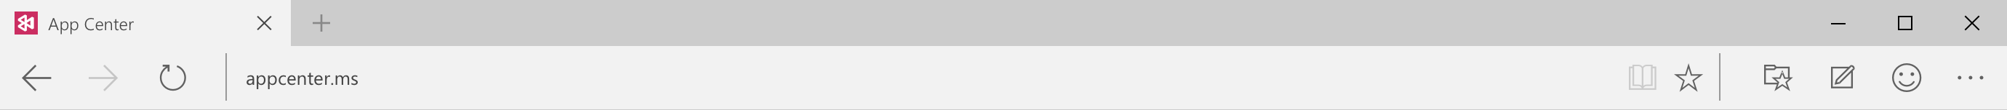
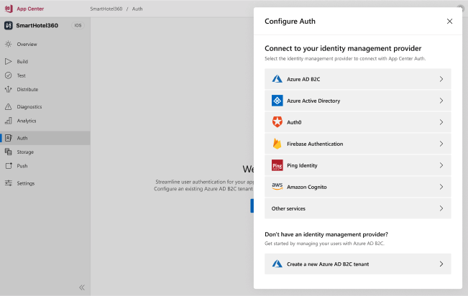

Auth Third Party Identity Providers

Slide 56
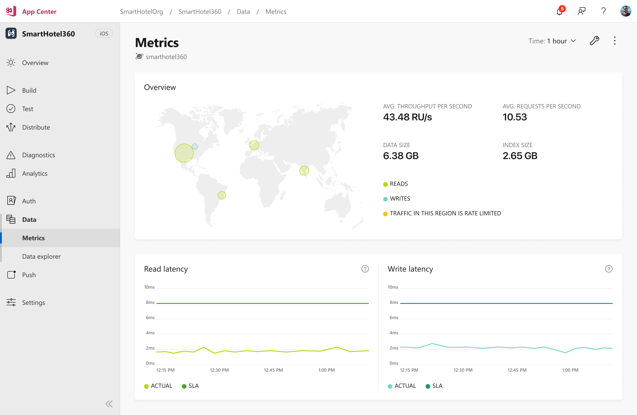
Data Metrics

Slide 57
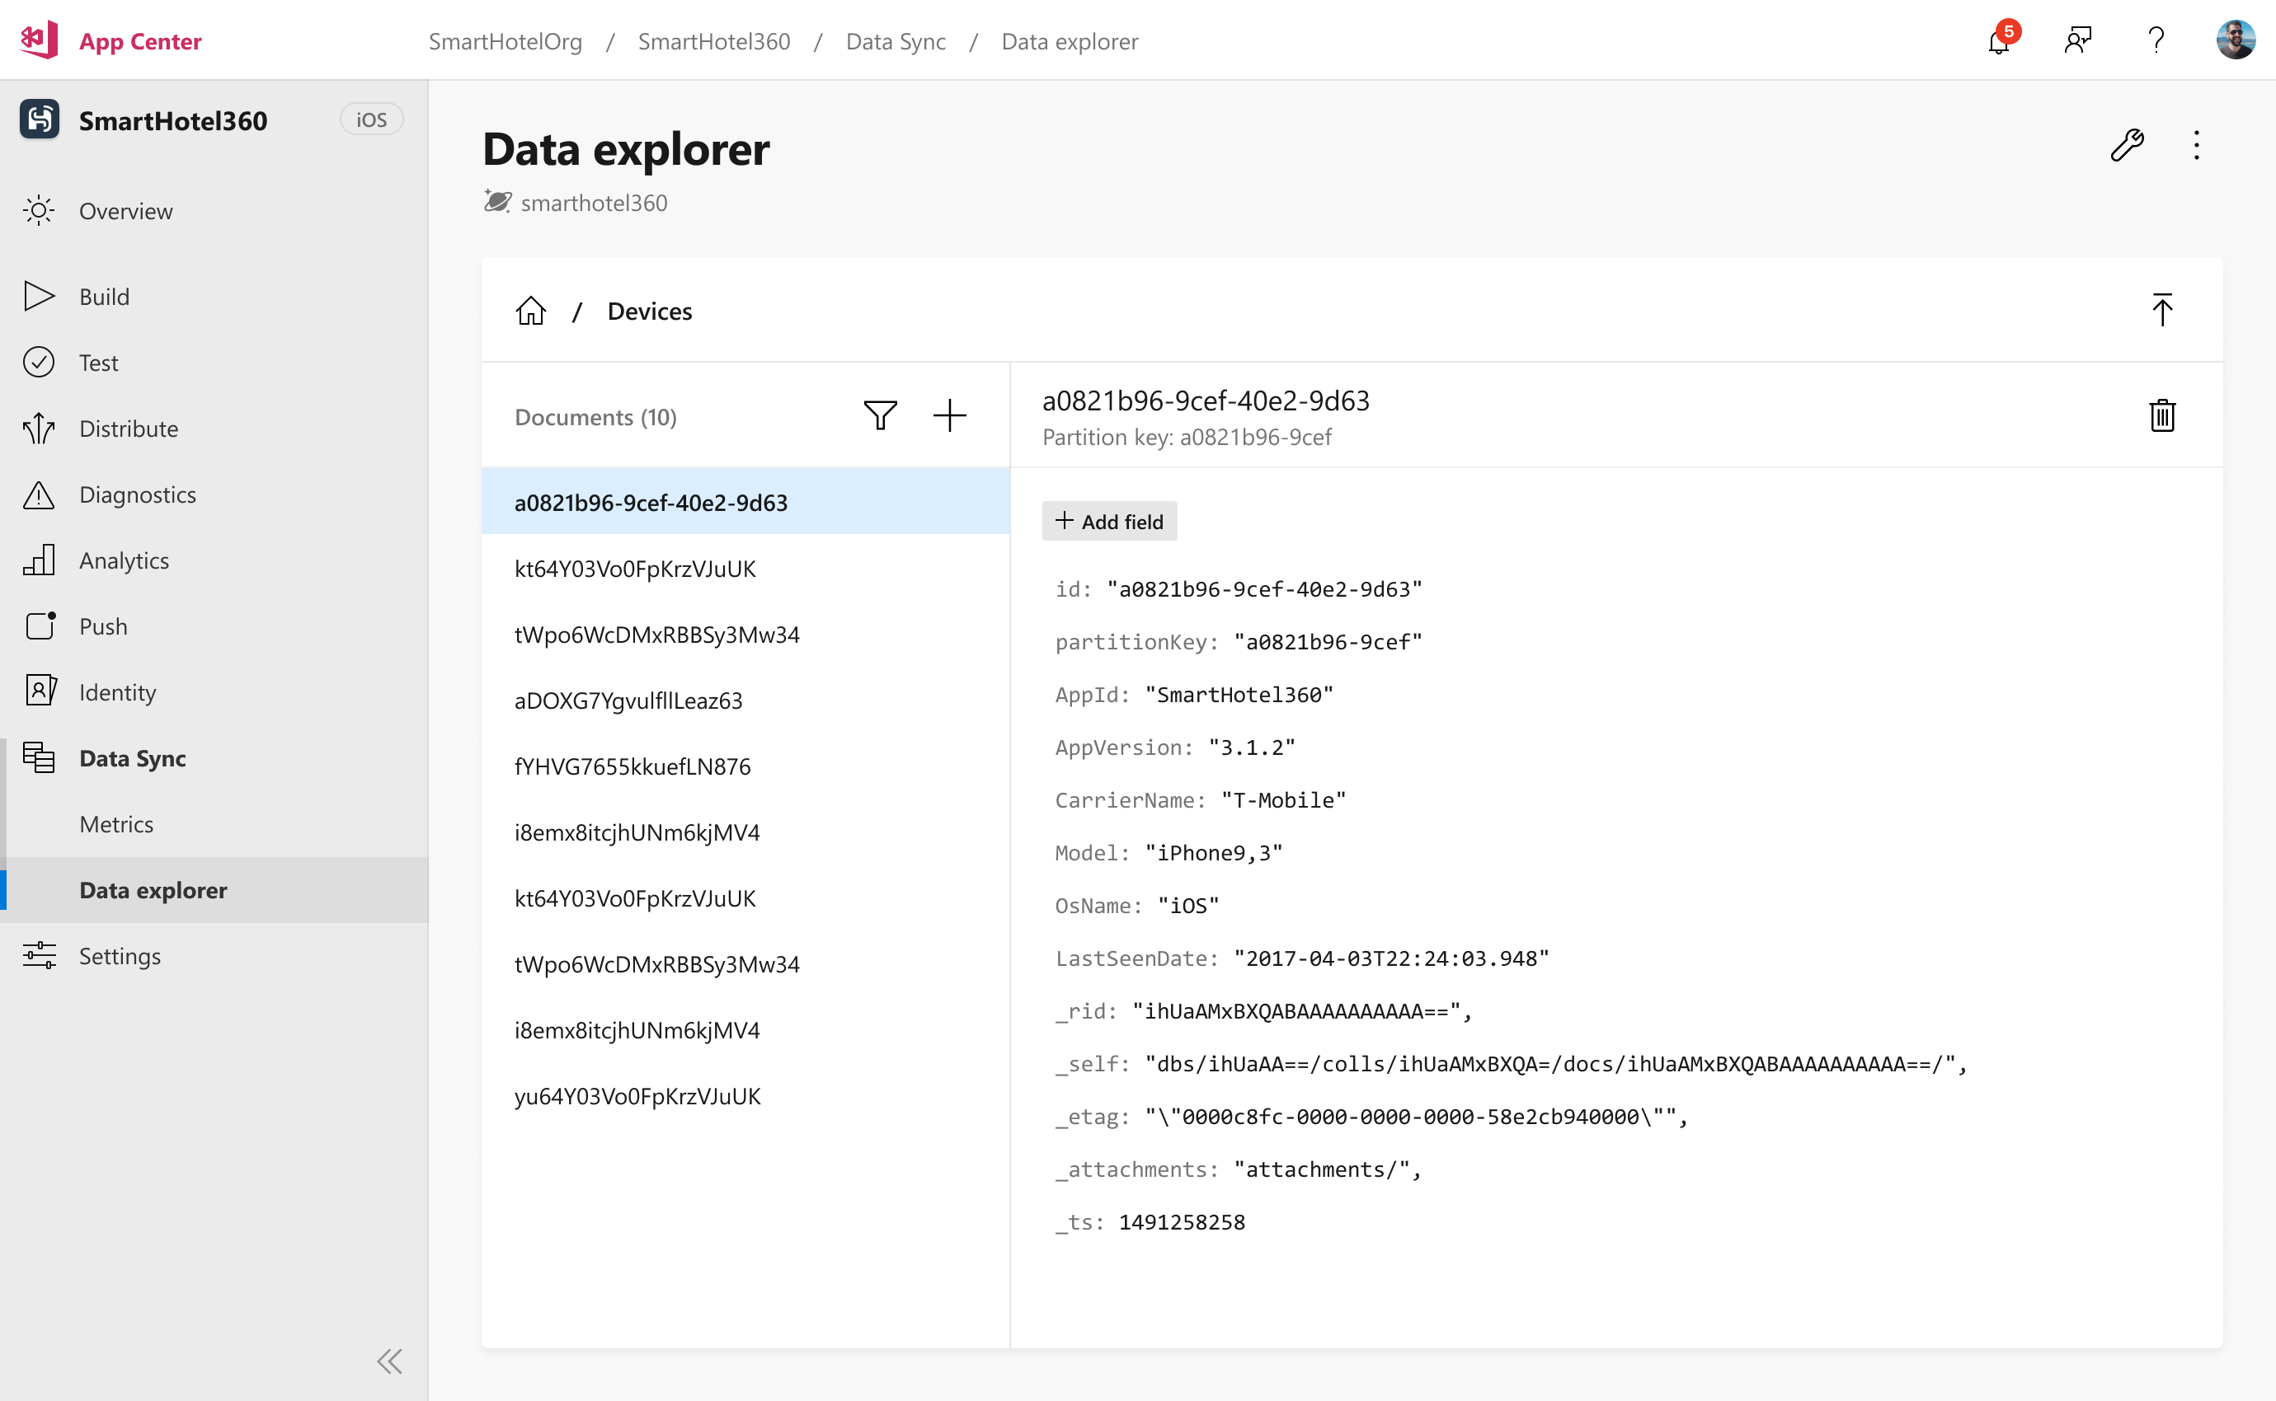
Data Browser

Slide 58

Data Free Tier
This slide should be a celebration. Any thoughts?

Slide 59
Community

Slide 60


Slide 61
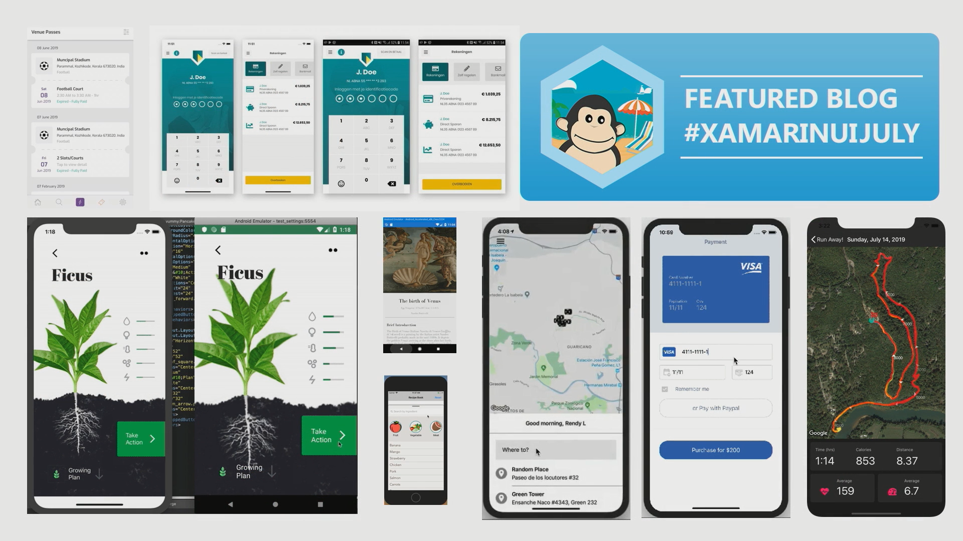

Slide 62
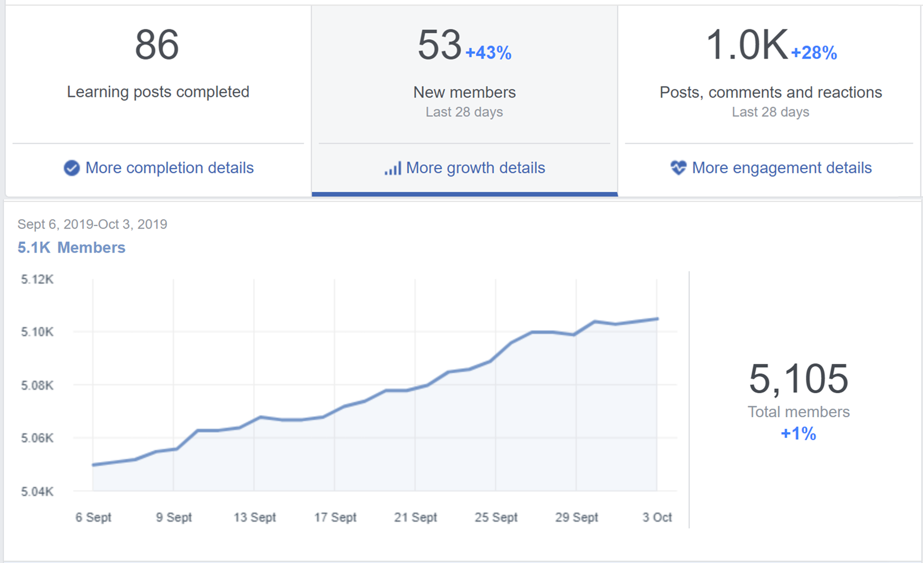
Xamarin Developers Vietnam

Slide 63
Thank you!
Khuong Nguyen
@khuongntrd

